Slide 1


Report on Optimizing Order Fulfilment
FOR STREAMLINE LOGISTICS SOLUTION
PREPARED BY:
EMMANUEL DARAMOLA

Slide 2
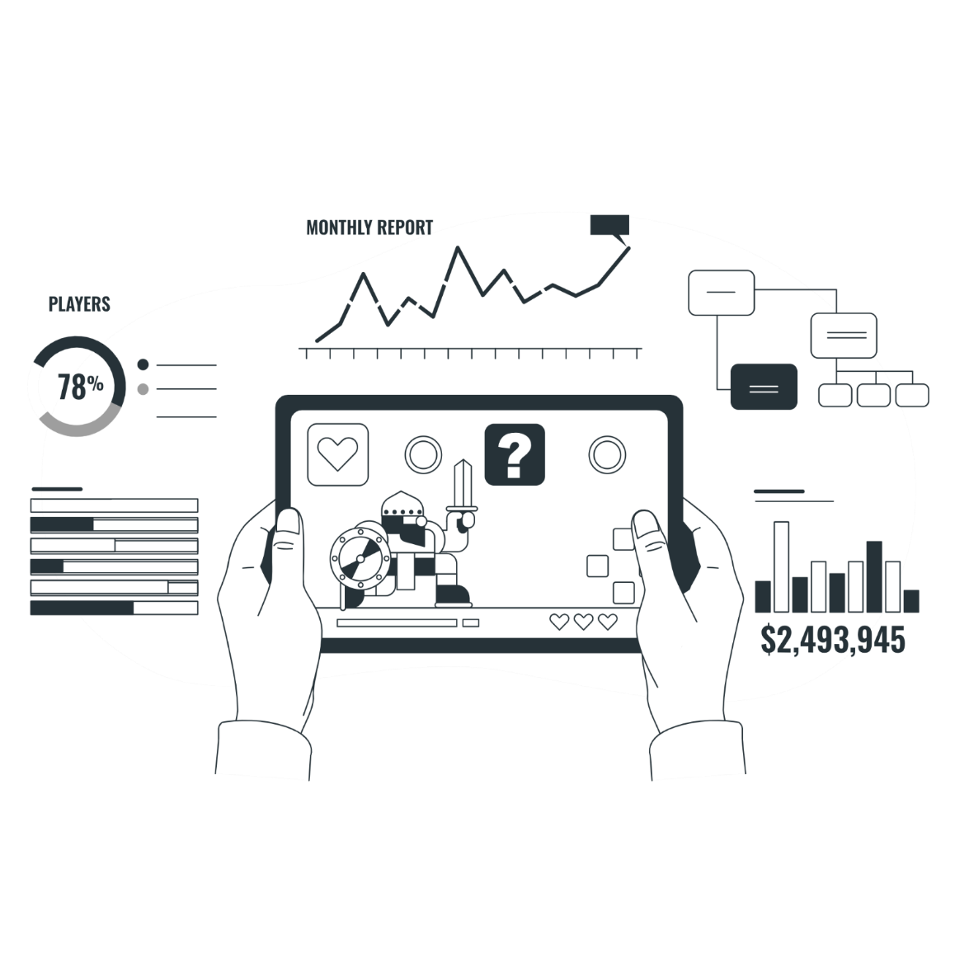
Overview
Top 10 Driver by Average Delay & Delivery Time
CONTENT
Order Completion Rate
Vehicle by Average Delay Time
Total Order per Route by Avg. Delay
Customer Satisfaction Feedback Entry
Average Delay & Delivery Trend by Weekday

Slide 3



PROJECT SUMMARY
BUSINESS PROBLEM
ANALYSIS
KPIs
The purpose of this report is to examine the company’s
Mounting Order Backlogs
Customer Frustration from delayed deliveries
Visibility Gap leading to communication and rising dissatisfaction
Escalating Costs which affects operational expenses
Microsoft Excel tool was utilised to analyse this report and create a dashboard for visualisation. To determine important business KPIs to guide decision-making, a number of calculations were performed.
Key performance indicators in this report include the Order Completion Rate, Customer Satisfaction Rate, Average Delay Time, Average Delivery Time, Delay Impact, Backlog Rate.

Slide 4

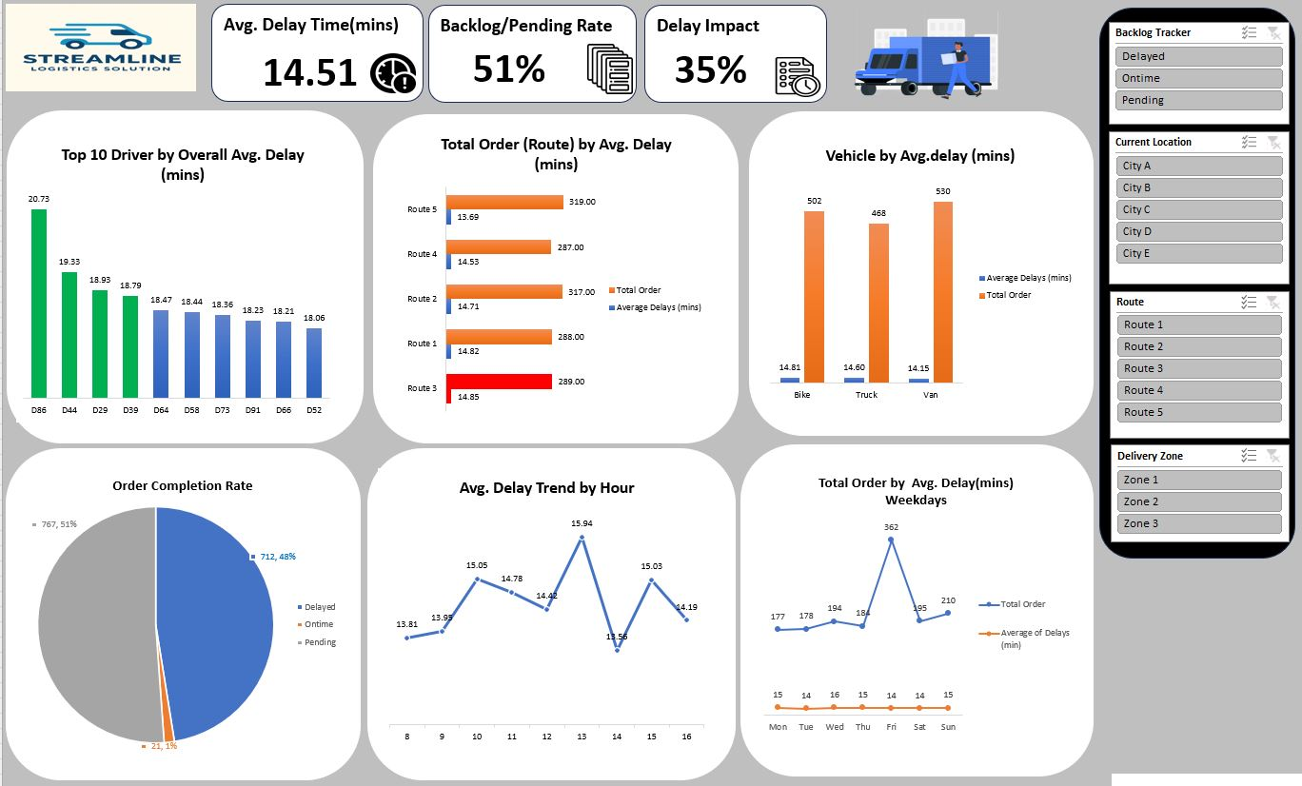
DELAY DASHBOARD

Slide 5
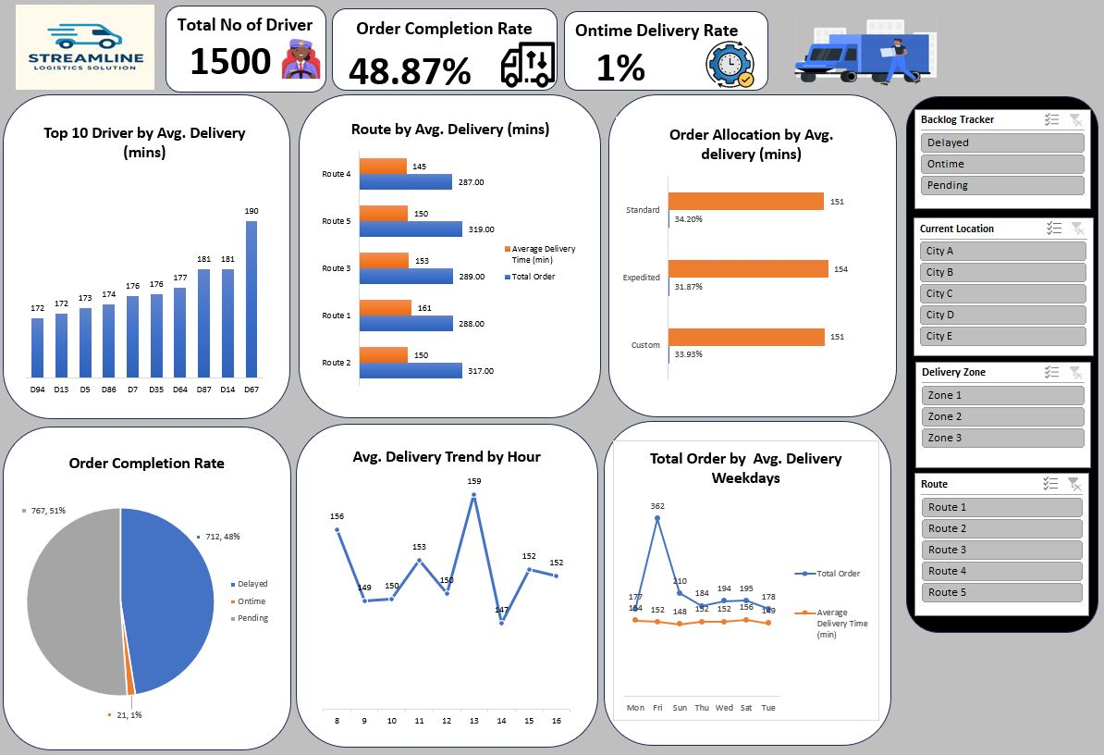
DELIVERY DASHBOARD

Slide 6
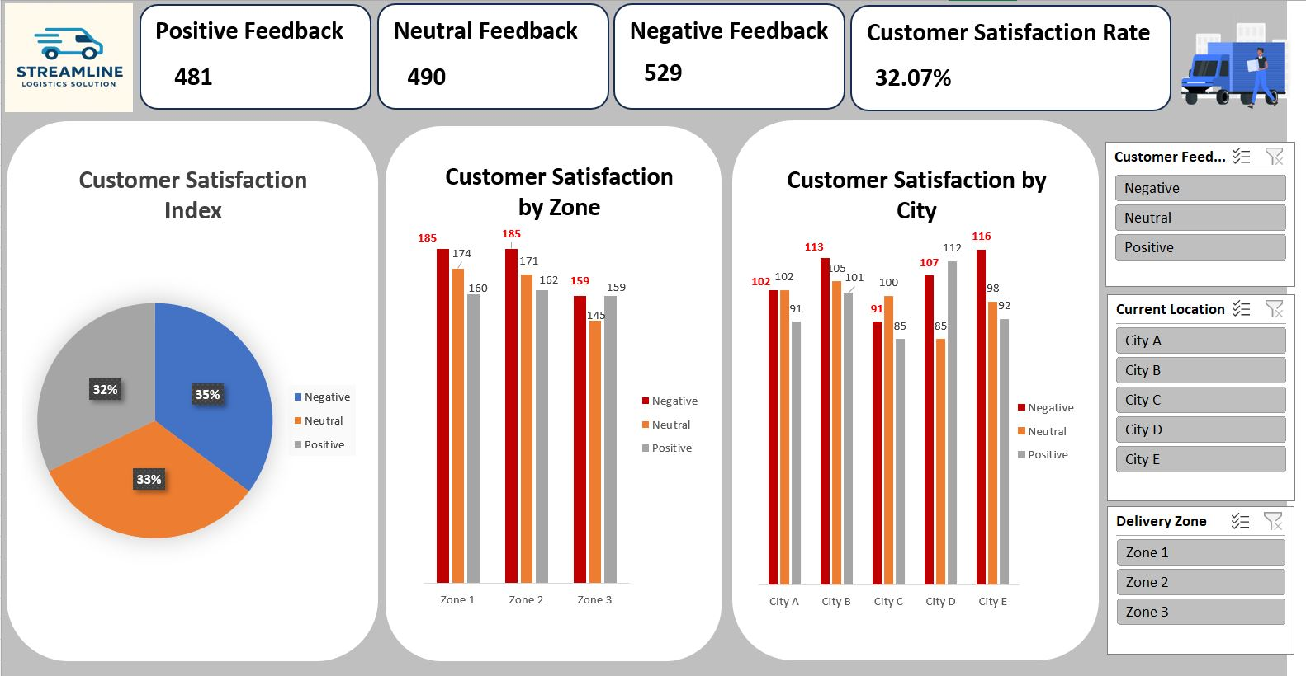
CUSTOMER SATISFACTION DASHBOARD

Slide 7
TOP 10 DRIVER BY AVERAGE DELAY & DELIVERY TIME
The Top 10 Driver having the most Delay Time(mins) include D86, D44, D29, D39, D64, D58, D73, D91, D66, D52 among all the Drivers.
The Top 10 Driver having the most Delivery Time(mins) include D94, D13, D5, D86, D7, D35, D64, D87, D14, D67 among all the Drivers.

Slide 8
ORDER COMPLETION RATE
Comparative analysis of the order status measured by the delay time generated for all orders.
The number of orders completed without a delay is 21 which is about 1% of the order completion rate.
The number of orders completed with a delay is 712 which is about 48% of the order completion rate.
The number of orders pending is 767 which is about 51% of the order completion rate.

Slide 9
AVERAGE DELAY BY HOUR
The highest avg. delay occur within the 13th hour of the day

Slide 10
CUSTOMER SATISFACTION BY ZONE AND CITY
zone 1 and zone 2 has same (185) negative feedback which is 12.33% of the feedback from the customer in the 3 Zones
City E and City B records 136 and 113 negative feedback respectively which is 7.73% and 7.53% respectively of the feedback from the customer from the 5 cities

Slide 11
CUSTOMER SATISFACTION RATE
Comparative analysis of the Customer Satisfaction measured by the metrics ( Positive, Neutral, Negative).
481 Positive feedback was received which is about 32% of the Customer Feedback.
490 Neutral feedback was received which is about 33% of the Customer Feedback.
529 Negative feedback was received which is about 35% of the Customer Feedback.

Slide 12


RECOMMENDATION
Driver & Route Optimization
Order Prioritization & Fulfilment
Fleet Management
Implement GPS route optimization to reduce delays for high-delay drivers (D86, D44, D29).
Introduce a Driver Performance Scorecard to track timeliness, route difficulty, and customer feedback.
Recognize top performers quarterly to improve morale and performance consistency.
Use telematics data to monitor fuel consumption and idle time.
Phase in predictive maintenance using delay-time correlation to vehicle type.
Establish a priority matrix for expedited and high-value orders.
Introduce automated scheduling that pairs vehicle type with order weight and destination to minimize under/over utilization.

Slide 13
RECOMMENDATION
Customer Experience
Allocation Priority
Address the 35% negative feedback rate by improving ETA communication.
Create real-time delivery tracking portals and proactive delay notifications
More priority to be give to expedited allocation orders as they will generate more revenue in the long run

Slide 14
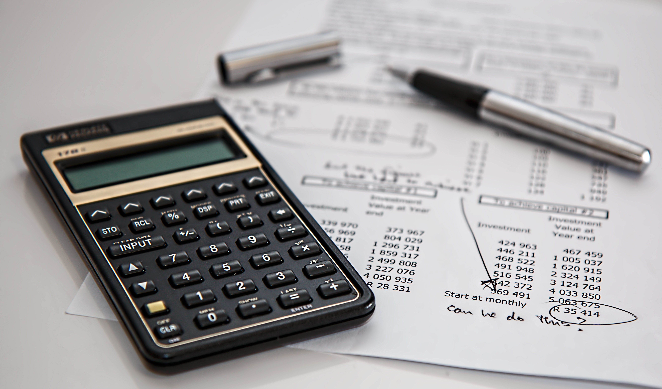
CONCLUSION
The Total Driver is calculated to be 1500
The Order Completion Rate is 48.87%
The Delay Impact is 35%
The Ontime order completion rate is very low(1%).

Slide 15
THANK YOU

